Slide 1
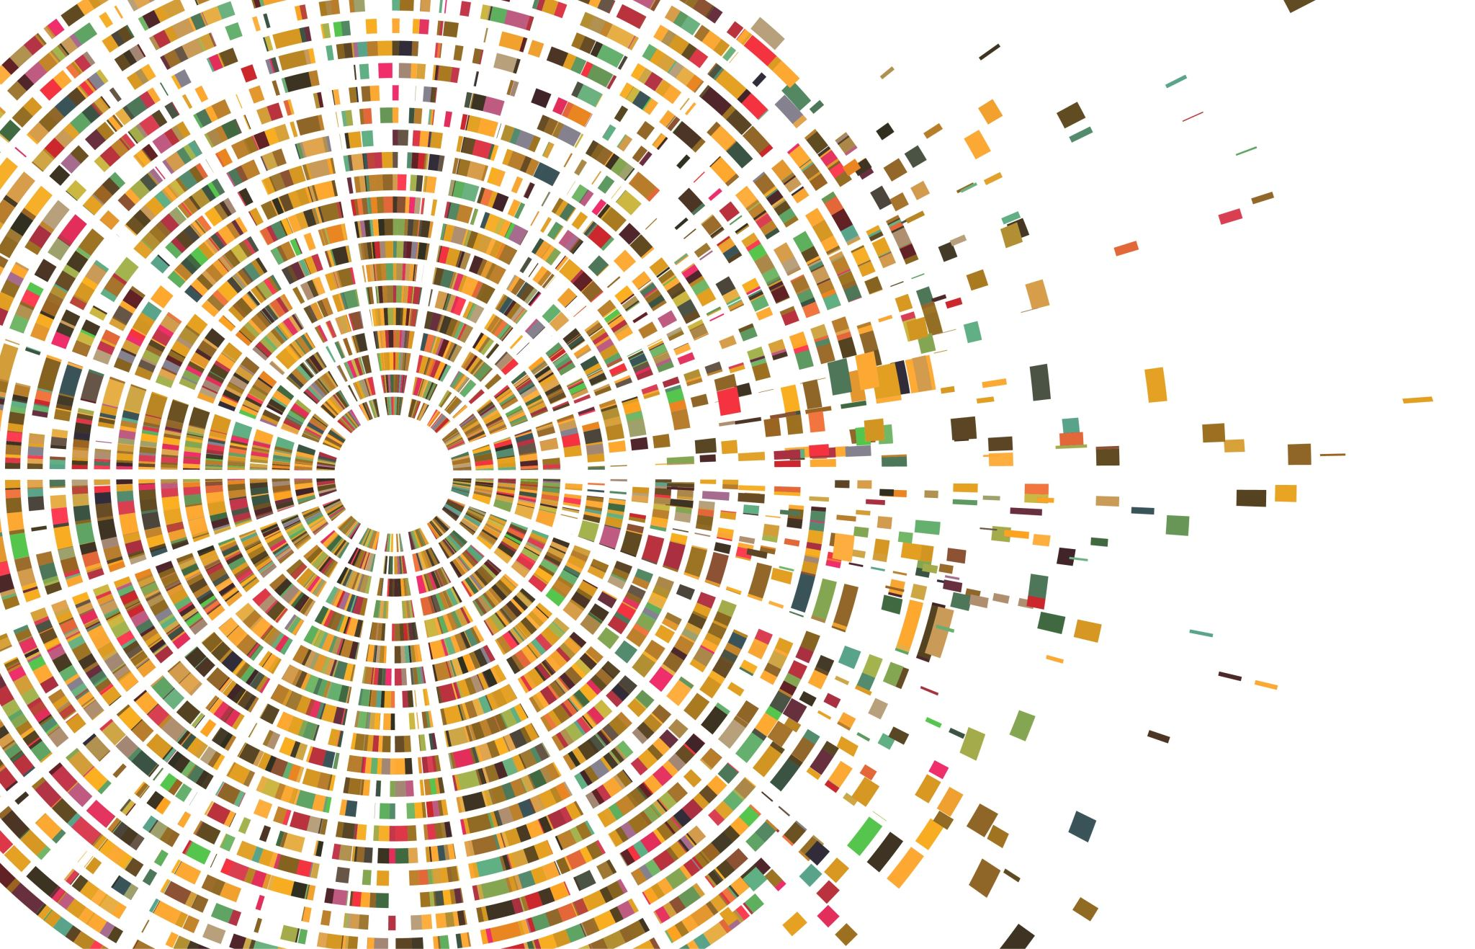
MNSIT
Classification of handwritten digits
Submitted by:
Tushar pagadala Ashok
Jackson Alexander Krishika Singh
Shenckerr Gollapudi

Slide 2
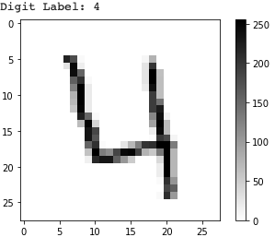
Objective
Develop a model using Support Vector Machine and CNN
classify the handwritten digits from 0-9 based on the pixel values given as features
Predict what digits they are

Slide 3
Algorithms Used
Support Vector Machine
Convolutional neural networks

Slide 4
Support Vector Machine Model Approach
Feature scaling
PCA Decomposition
Selecting the an appropriate kernel Type – RBF or linear
Building the model with Optimal hyperparameters
Evaluating unknown test data from kaggle

Slide 5
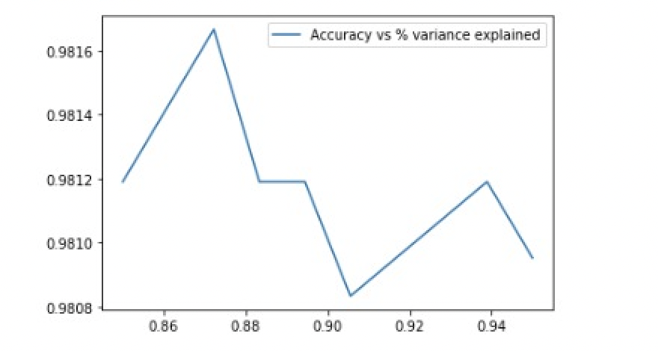
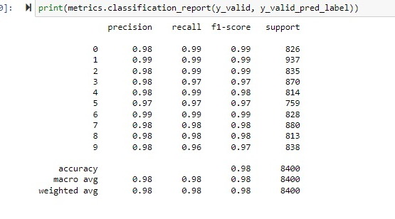
Support Vector Machine Model Observations and plots
After running the SVM using RBF kernel, the accuracy peaked when n_components is around 87%

Slide 6
Convolutional Neural Network Approach
Set data features and labels scaling and Reshape
One-Hot Encoding
Split training and valdiation set
Normalization
Data augmentation
Model training

Slide 7
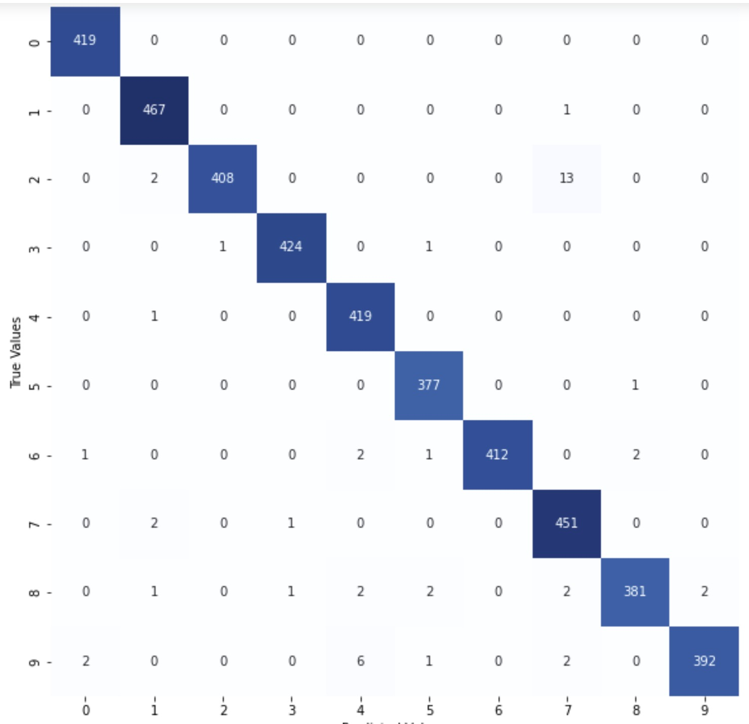
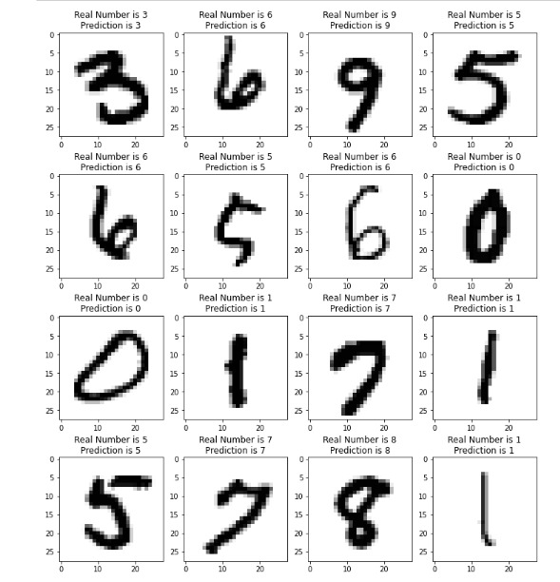
Convolutional Neural Network Model Observations and plots
After running the model, the predicted numbers are matching with the number in the image
Plotting confusion matrix on the validation data set

Slide 8
Conclusion based on Support Vector Machine Model
There was no need of any outlier treatment. There was no need for dummy variables or any conversion to categorical variables. Scaling or Normalization may be required before PCA.
The model was trained on two different kernel types - RBF and Linear. RBF was giving the highest accuracy explaining 86% variance in the data set.
With _components= 0.86, C = 10 and gamma = 0.01, Training samples have significant impact on the model - giving an accuracy of ~99%
Accuracy when predicted labels (predicted on test data) are uploaded to Kaggle gives us around 98%

Slide 9
Conclusion based on Support Vector Machine Model
There is no need of any outlier treatment or pre-processing of the dataset other than scaling or normalization.
We have chosen Keras Sequential Model ; This model gives us an accuracy of 98.5% on the test data when uploaded to kaggle

